Slide 1
《英语国家社会与文化入门》(下册）
The Society and Culture
of Major English-Speaking Countries
An Introduction
(Book Two)

Slide 2
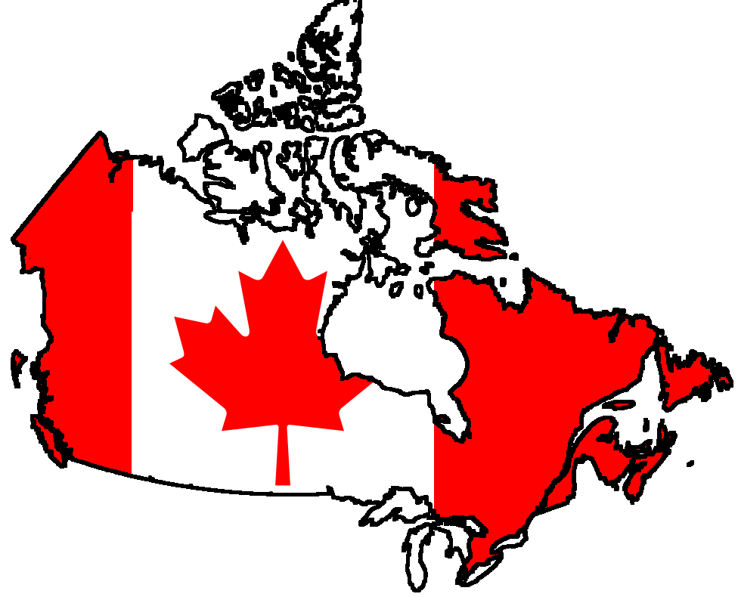
Canada Unit 17 The Country and its People
Welcome to Canada Bienvenue au Canada

Slide 3
Quiz
Give the English for the following:
加拿大特征/身份
加拿大滨海诸省
大草原区
北欧海盗
加拿大邦联

Slide 4
Focal Points
the Canadian identity
the regions of Canada
the Yukon and the Northwest Territories
British Columbia
the prairie provinces
Central Canada -- Ontario and Quebec
the Maritimes ( the Atlantic regions )
the First Nations ( the Aboriginal people)
European settlement in Canada
the Confederation
the origin of the word "Canada"

Slide 5
This Unit is Divided into Four Sections
A Brief introduction
The Regions of Canada
History
What’s in a Name?

Slide 6
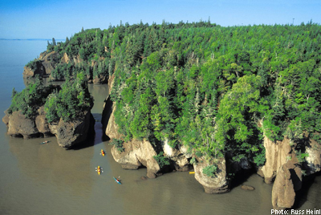
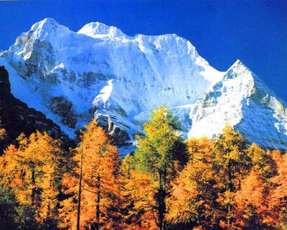
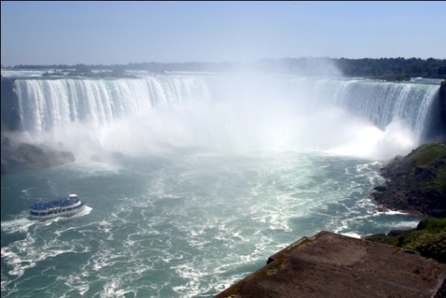
I. A Brief Introduction
Basic facts about Canada:
Area total – 9,976,140 km²
Population -- 35,702,707 (as of 2015)
Capital -- Ottawa
National Day – Canada Day, 1 July (1867)
Official Languages -- English & French

Slide 7
I. A Brief Introduction
The Canadian Identity (What makes a Canadian Canadian?)
Bilingualism – English and French
Multiculturalism – diverse cultural makeup
Historical links with the Great Britain
Close and intimate relations with the U.S.
(difficult to generalize and define)

Slide 8
II. The Regions of Canada
the second largest country after Russia
10 provinces and 3 territories
“from sea to sea” (the Pacific, the Atlantic)
the longest undefended national border (with the U.S.)

Slide 9
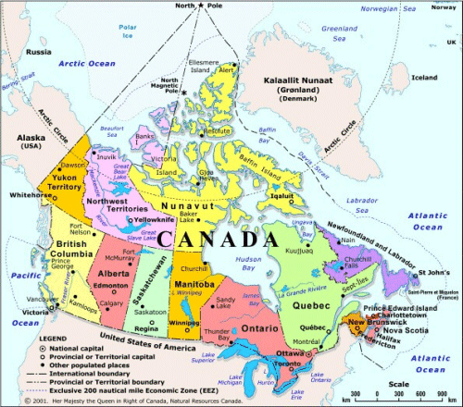

Slide 10
II. The Regions of Canada
The North
-- “the land of mid-night sun”
-- 3 territories: the Yukon,
the Northwest Territories
the Nunavut
-- the Inuits, cold weather
-- traditional economy (hunting and trapping animals)
-- “the Gold Rush” (late 1800s; the Yukon)
-- oil and gas deposits

Slide 11
The North
The Inuits and the igloo

Slide 12
II. The Regions of Canada
The West (British Columbia)
-- the Rockies
-- economy: hydroelectricity power; forestry industry
The Rockies and Lake Louise

Slide 13
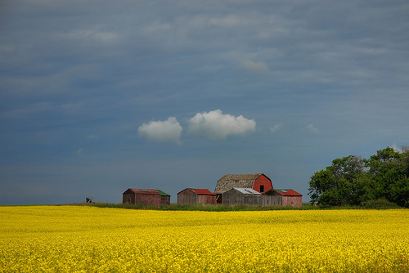
II. The Regions of Canada
* The prairies
-- Alberta, Saskatchewan, Manitoba
-- farming (Canada’s breadbasket)
-- rich in energy resources

Slide 14
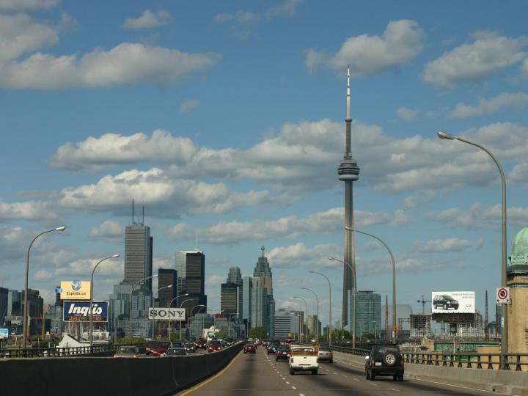
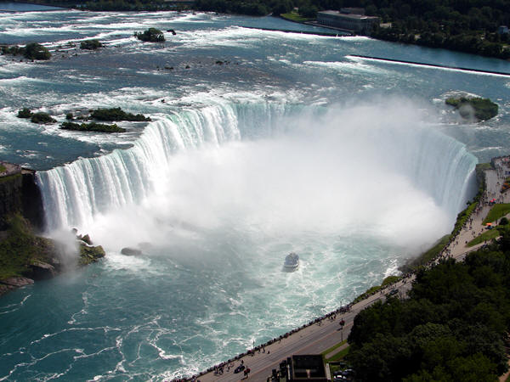
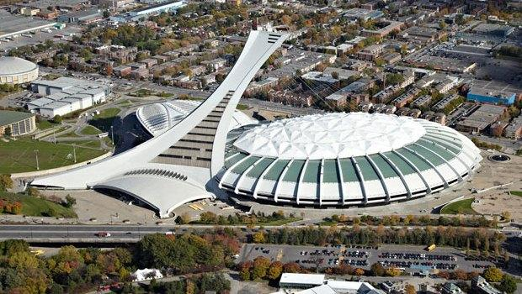
II. The Regions of Canada
* Central Canada
-- Ontario, Quebec
-- industrial heartland, most densely populated
-- Toronto, Montreal
Niagara Falls
Montreal Olympic Stadium
Toronto city skyline

Slide 15
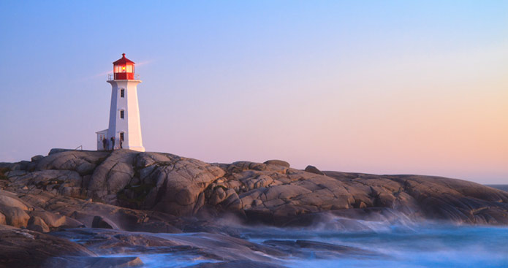
II. The Regions of Canada
The Atlantic regions (The Maritimes)
-- New Brunswick, Nova Scotia, Prince Edward Island and Newfoundland
-- economy: fishing, tourism, farming
Peggy’s Cove, Nova Scotia

Slide 16
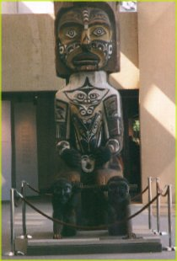
III. History
The First Nations
Earliest inhabitants of Canada (10,000 years ago)
Different groups, different
cultures, languages and lifestyle
Live in harmony with nature

Slide 17
III. History
The European settlement
Vikings – around year 1000
Jacques Cartier – 1534, the Gulf of St. Lawrence
Samuel de Champlain – 1608, 1st French settlement along the St. Lawrence River, “Father of New France”;
the earliest major settlements in Nova Scotia in 1604 and Quebec in 1608

Slide 18
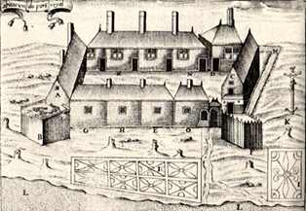
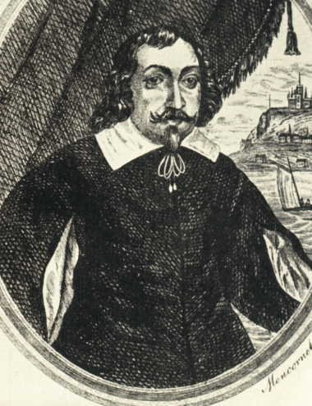
III. History
Port-Royal Habitation, the first settlement in North America
Samuel de Champlain

Slide 19
III. History
French colonists first settled Canada.
The earliest major settlements were established in Nova Scotia in 1604 and Quebec in 1608.
Fur trade
French Vs. English settlement;
Company of New France Vs. Hudson’s Bay Company

Slide 20
III. History
The 18th century
Events that affected Canada’s early history
-- wars between Aboriginal tribes and French and English settlers
-- wars between Britain and France in Europe
-- American history (the Independence War; the United Empire Loyalists)
-- French Revolution

Slide 21
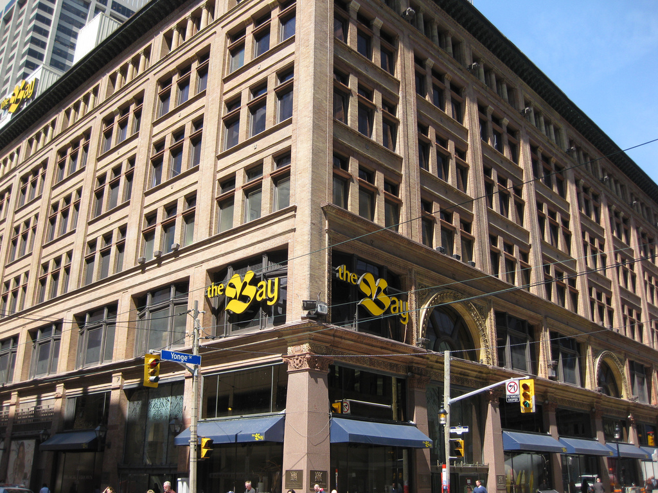
Hudson Bay Company Then and Now
HBC department store in downtown Toronto

Slide 22
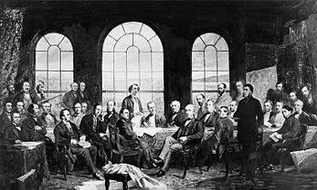
III. History
Confederation
Quebec, Ontario, New Brunswick and Nova Scotia joined to form confederation (1867).
Delegates met at the Quebec Conference for confederation

Slide 23
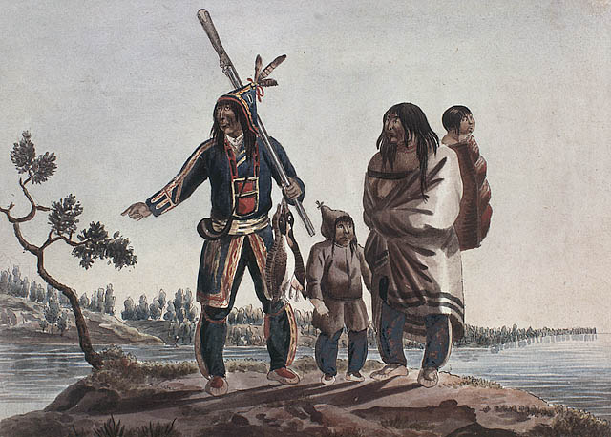
IV. What’s in a Name?
Possible origins for the name “Canada”
(indication of diversity of culture)
Spanish for “nothing here” (Spanish explorers)
Languages of the First Nations
Cree, “clean land”;
Mohawk, “castle”;
Iroquois, “village”

Slide 24
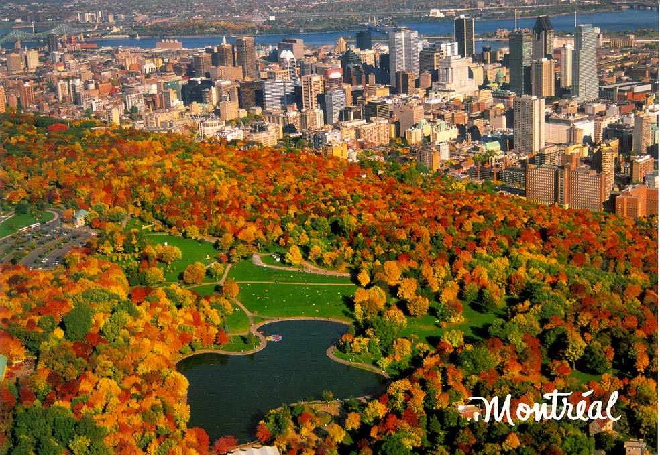
IV. What’s in a Name?
Place names that reflect the history of Canada and diversity of culture:
-- Halifax, Victoria (English rulers and nobles)
-- Montreal (French translation of "Mount Royal“)

Slide 25
IV. What’s in a Name?
Place names that reflect the history of Canada and diversity of culture:
Medicine Hat, Moosejaw (adventures of early explorers)
Sioux Lookout (early settlers keeping watch for native Indians)
- Great Bear Lake, Buffalo Narrows (different forms of wildlife

Slide 26
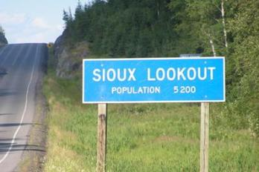
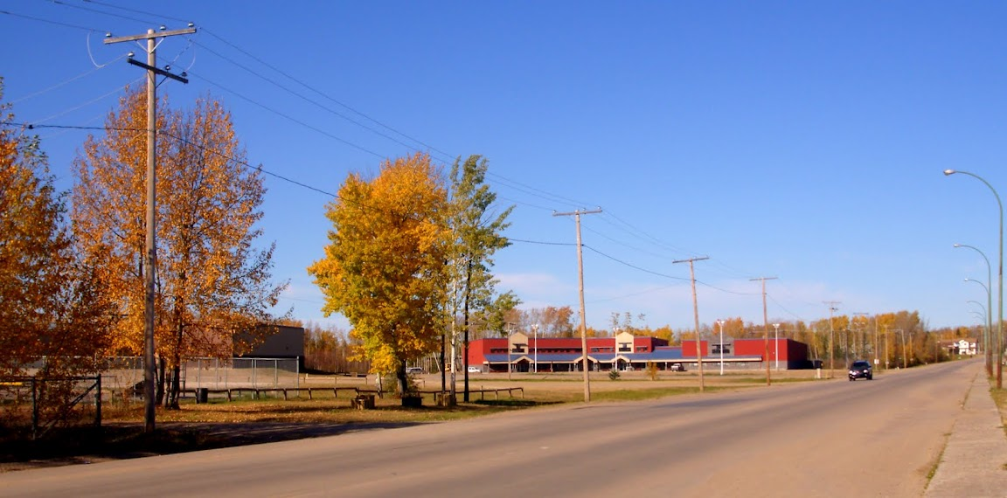
Sioux Lookout, Ontario
Buffalo Narrows, Saskatchewan

Slide 27
Questions for Discussion
Why is Canada regularly rated as having the best standard of living in the world?
Why do Canadians seek a national identity? What is so unique about Canadian culture?
What are the features of each of the regions of Canada?

Slide 28
The End
高等教育出版社
2015

